Slide 1
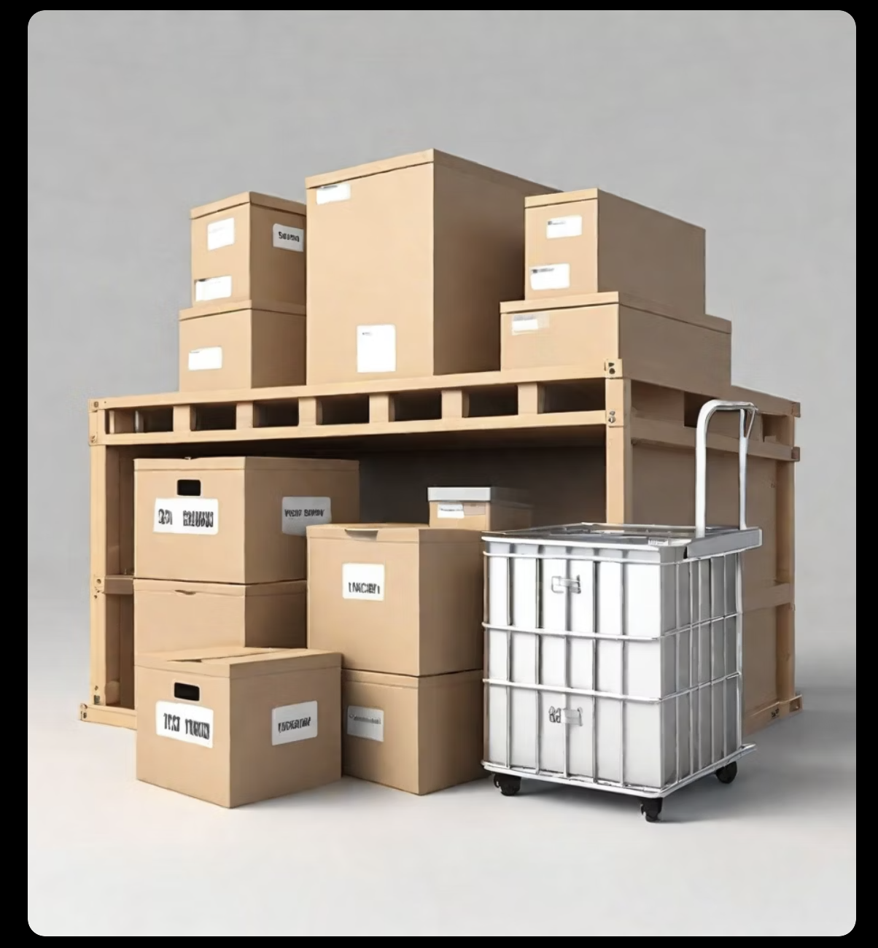
Integrating AI-Powered Chatbots with Predictive Inventory Management and Demand Forecasting

Slide 2
Problem Statement
Our proposal introduces a cutting-edge solution for inventory management that
integrates chatbot technology,
machine learning (ML) predictive analytics,
instant Interaction via Chatbot and real-time inventory tracking
This system is not only customizable to align with individual company requirements but also features trainable inventory algorithms to accurately forecast demand and optimize stock levels.

Slide 3
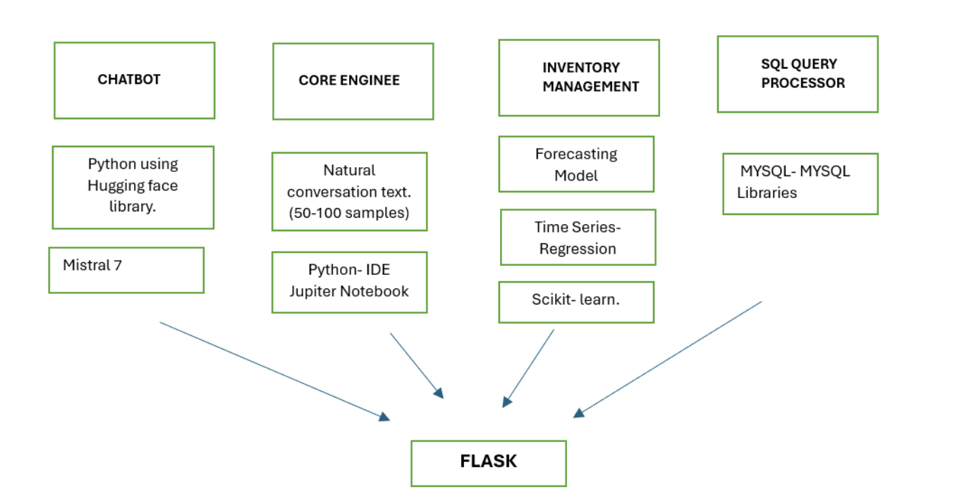
Methodologies

Slide 4
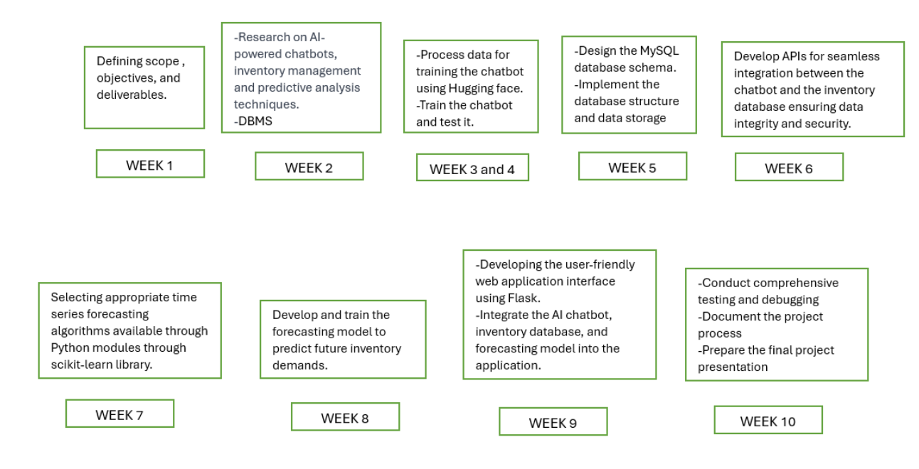
Project Time-Line

Slide 5
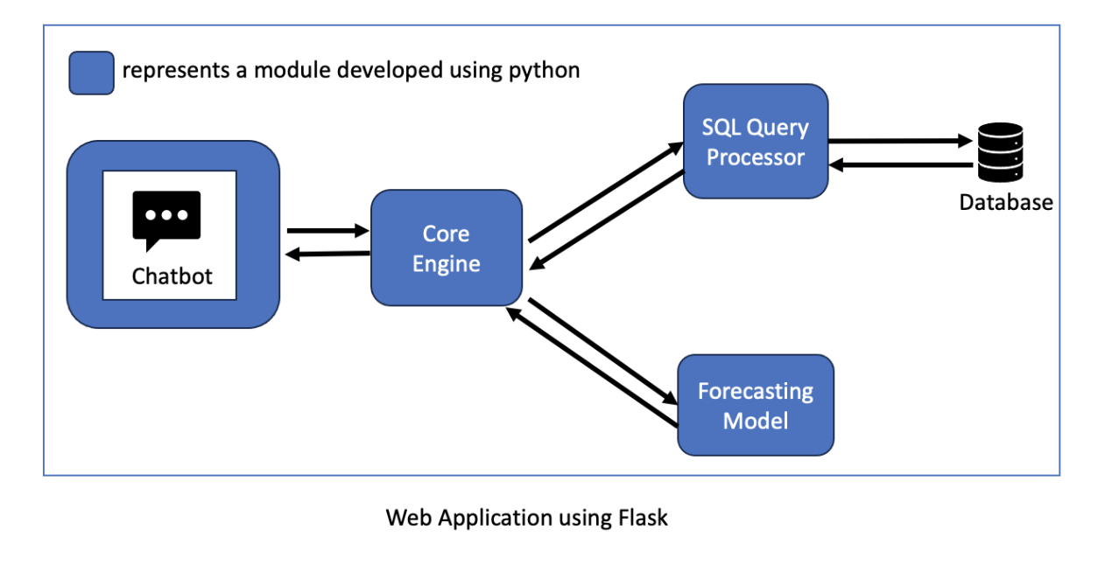
Project Work Flow

Slide 6

Thank you

